Slide 1
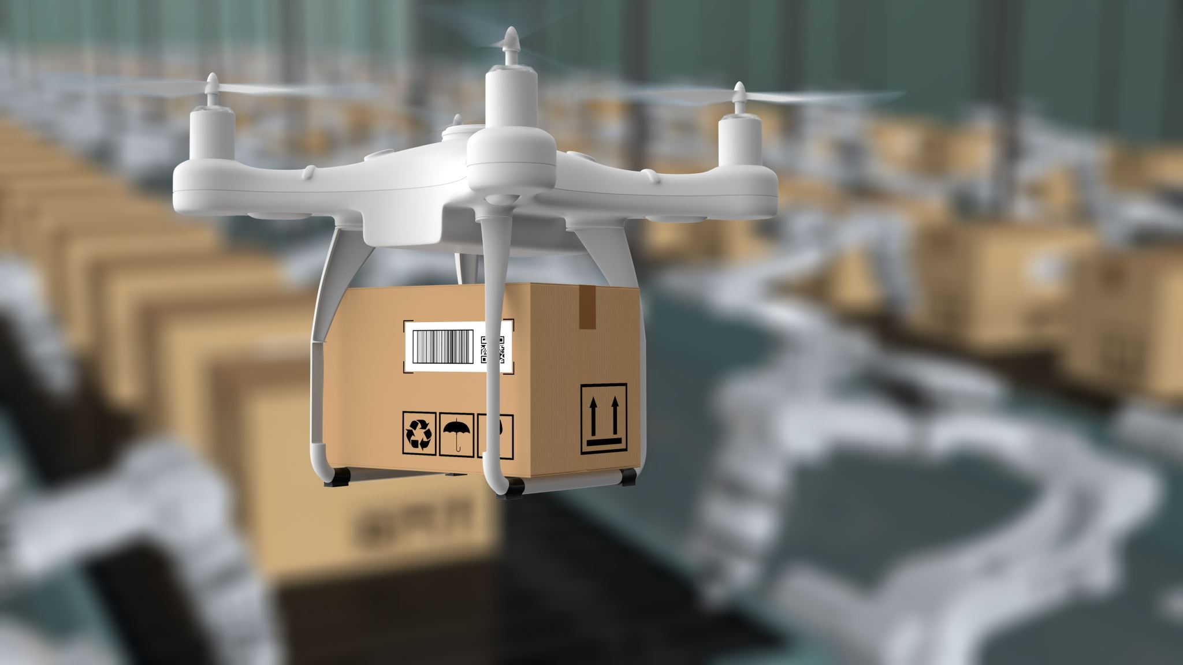
Product Presentation

Slide 2
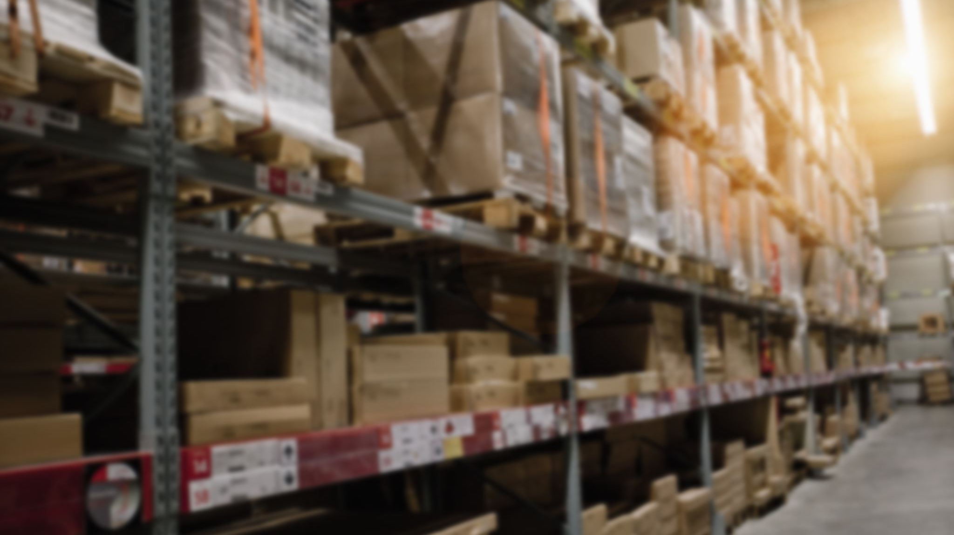
Main objectives of the system
A products orders (and sell) management system having in mind two distinctive aspects:
• The products being sold are stored in a (almost) fully robotized warehouse where customized automated guided vehicles (AGV) are used to pick-up orders’ products.
• The ability to specify and carry out questionnaires/surveys about any intended topic (e.g.: about a concrete product, a brand, the customer satisfaction regarding the system and/or regarding the delivery process) in an easy and integrated way

Slide 3

Adopted development process and planning

Slide 4

Our development process and planning is based on the scrum development process.
We have a list called a product backlog.
During sprint planning, we divide the tasks from the list, and decides how to implement those pieces.
Since we have a certain amount of time — a sprint — to complete the work, we need to follow up on daily progress.
Along the way, the ScrumMaster keeps the team focused on its goal.
We expect that at the end of the sprint, the work should be potentially shippable: ready to hand to a customer.
We end the sprint with a sprint review and retrospective.
As the next sprint begins, we divide more tasks and begins working again.

Slide 5

Teamwork methodology and conflict resolution strategy

Slide 6

As mentioned before, our teamwork methodology is based on scrum .
In terms of a conflict resolution strategy, we opt out to always verify each others opinions relative to the conflict, and decide what's best according to it.

Slide 7

Expected results and Product Quality

Slide 8
We expect to meet most, if not all, the expected tasks to be developed.
Having by then, a well-developed product with maximum value in terms of quality of software

